Slide 1
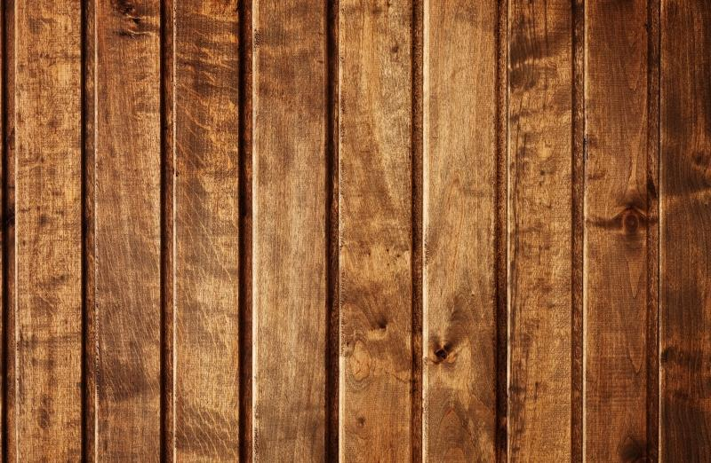
Decorative painting
By Lysenko Rinata and
Kirillova Milena

Slide 2
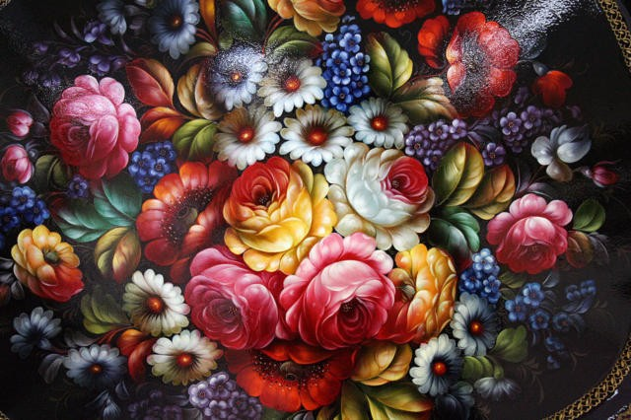
Decorative painting - is the art of decorating with paints and brush of any surface. The art of painting is to be distinguished from the painting. The painting should be considered as one of the most popular types of arts and crafts. In Russian folklore there are many varieties of this type of arts and crafts.

Slide 3
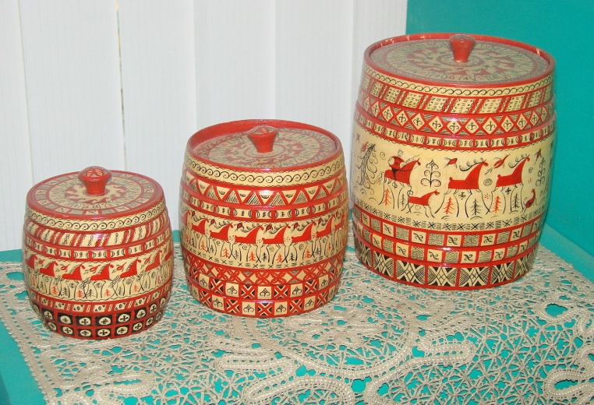
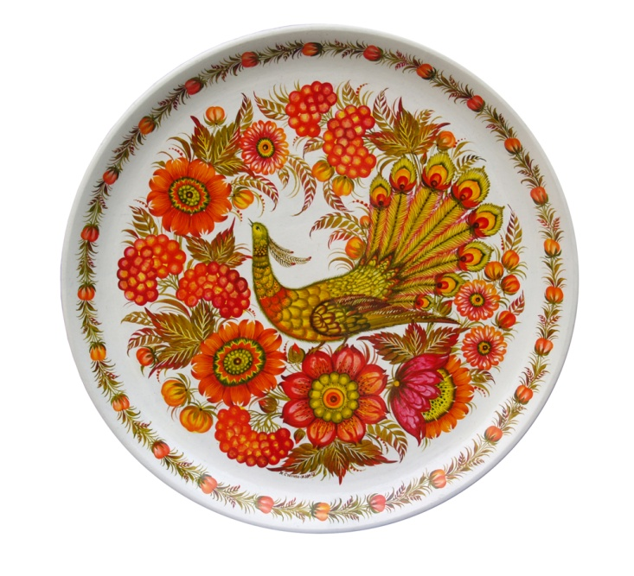
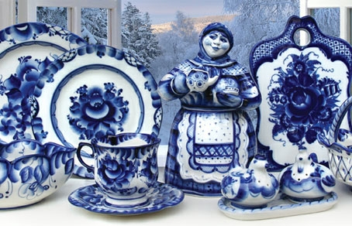
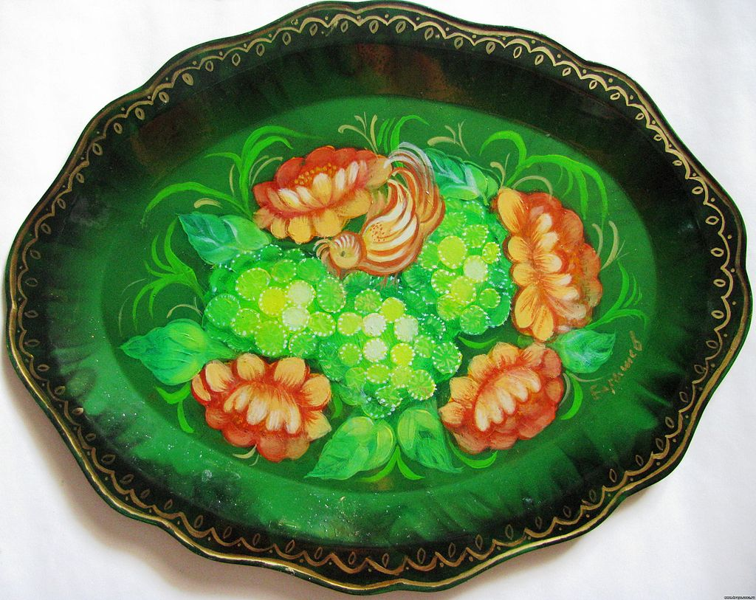
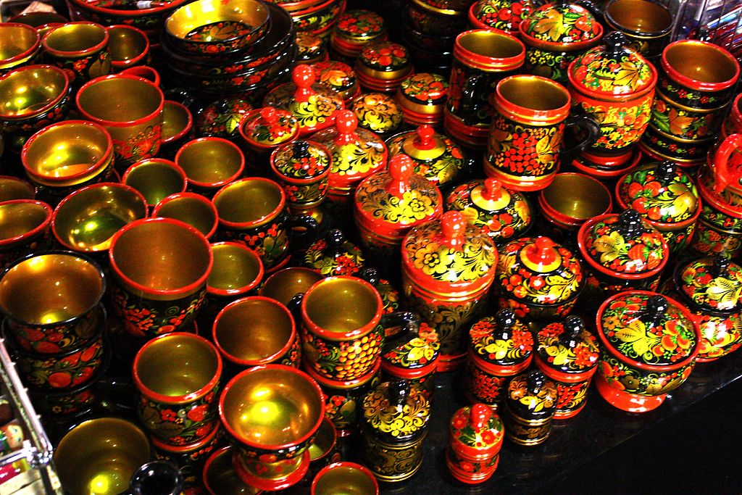
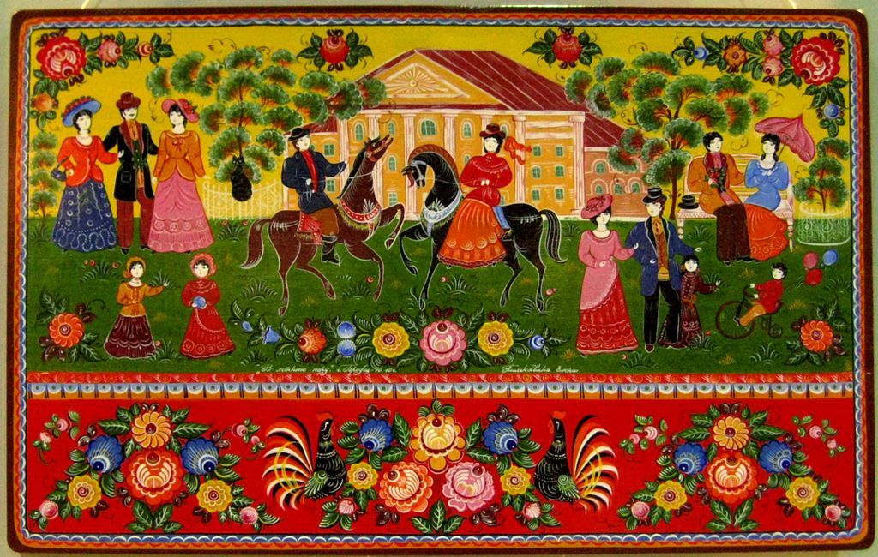
Decorative painting is:
Mezen painting
Petrikov painting
Gzhel
Gorodets painting
Khokhloma
Zhostovo painting

Slide 4
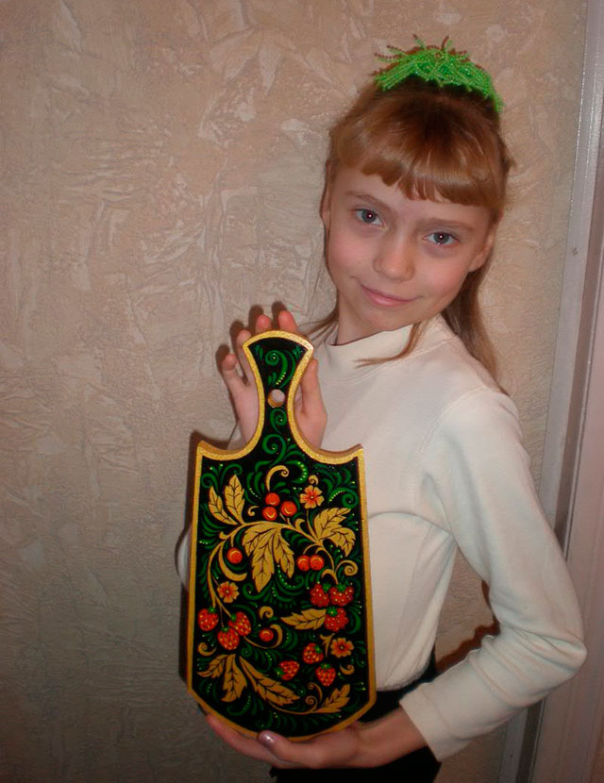
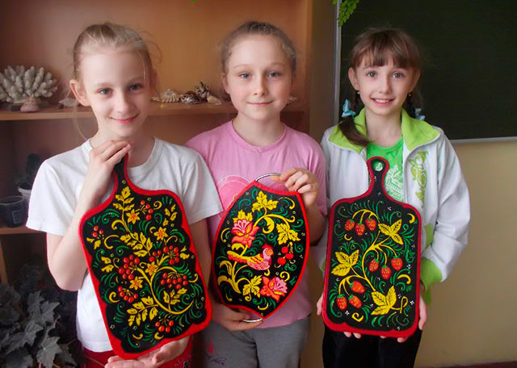
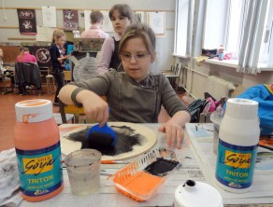
This hobby is very attractive. A lot of children is fond of it!

Slide 5
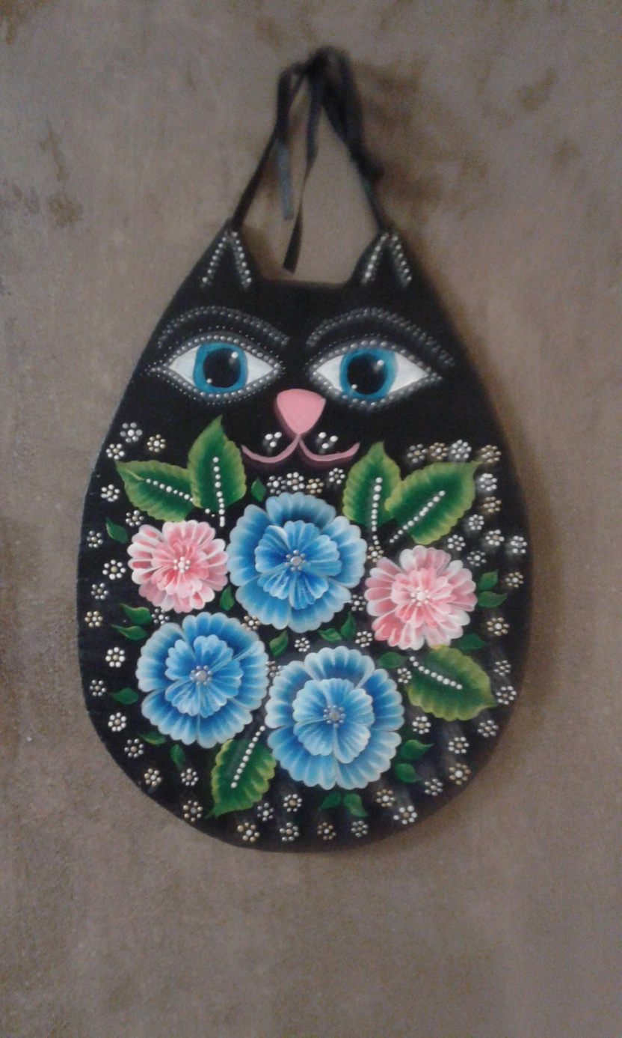
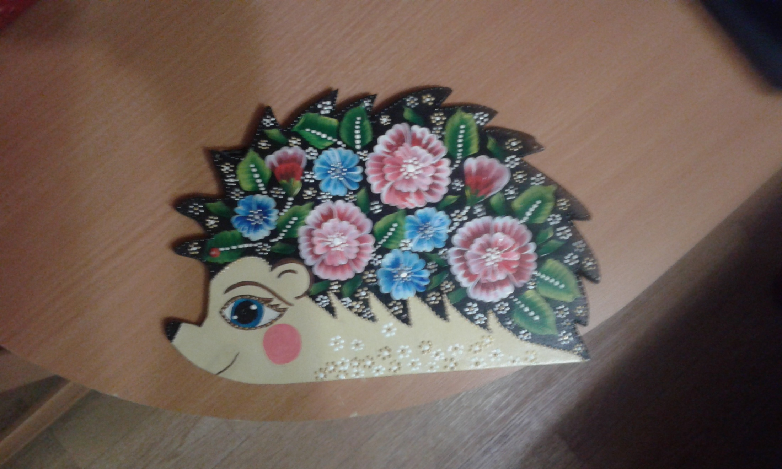
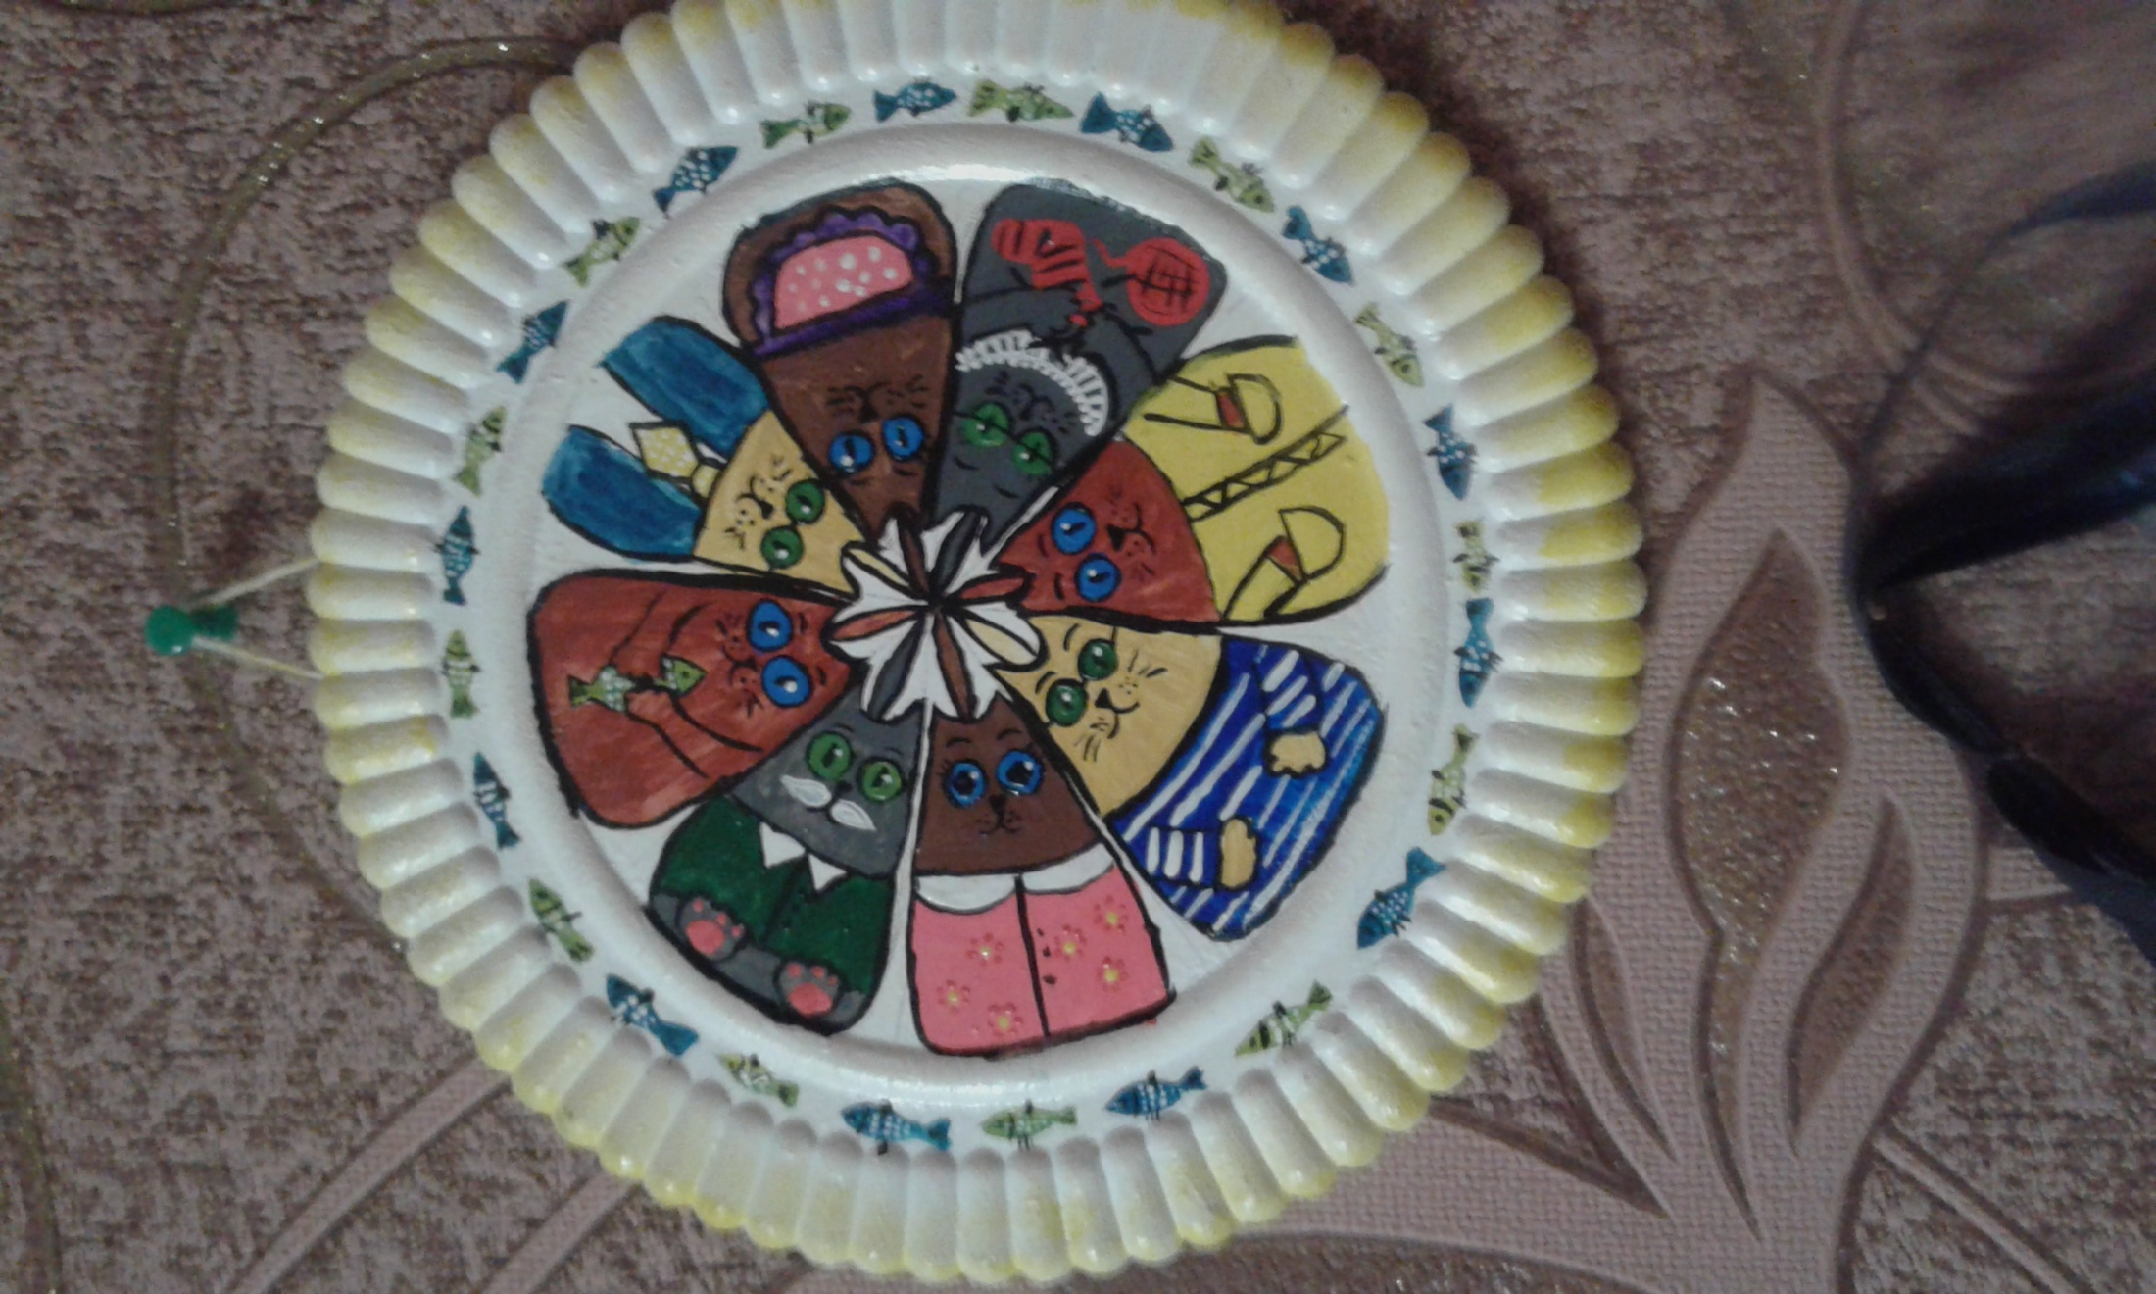
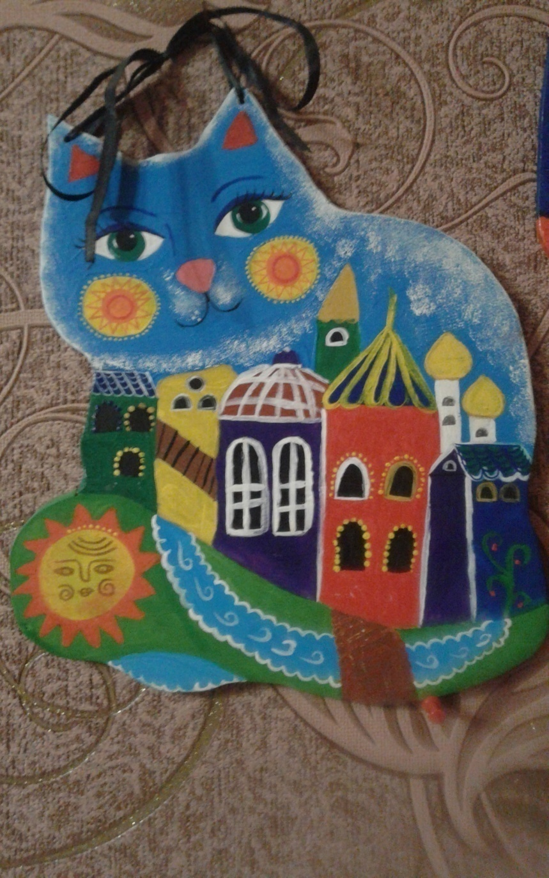
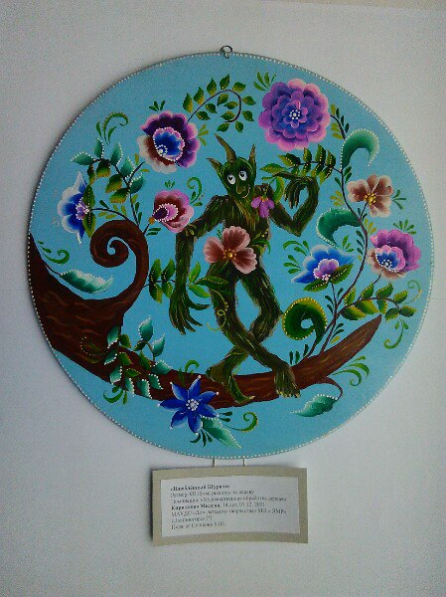
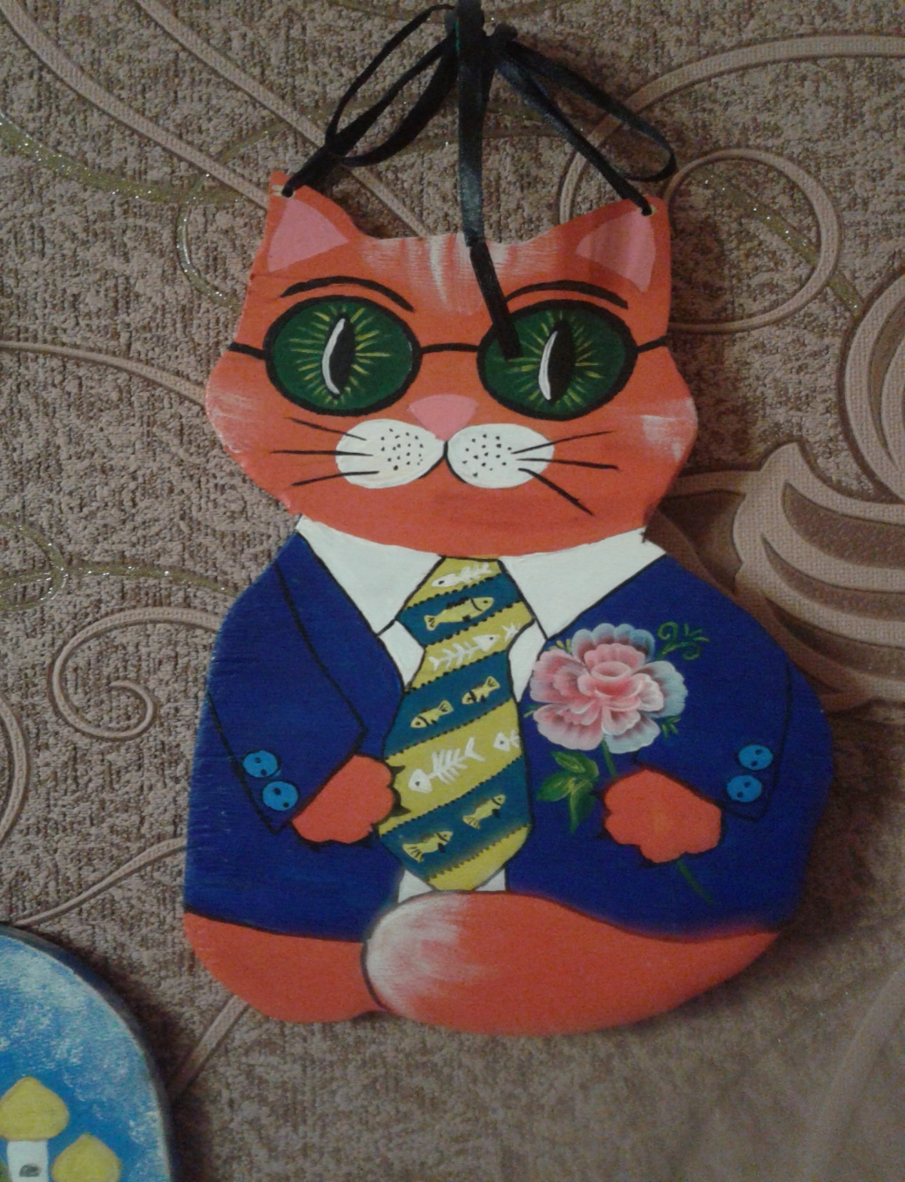
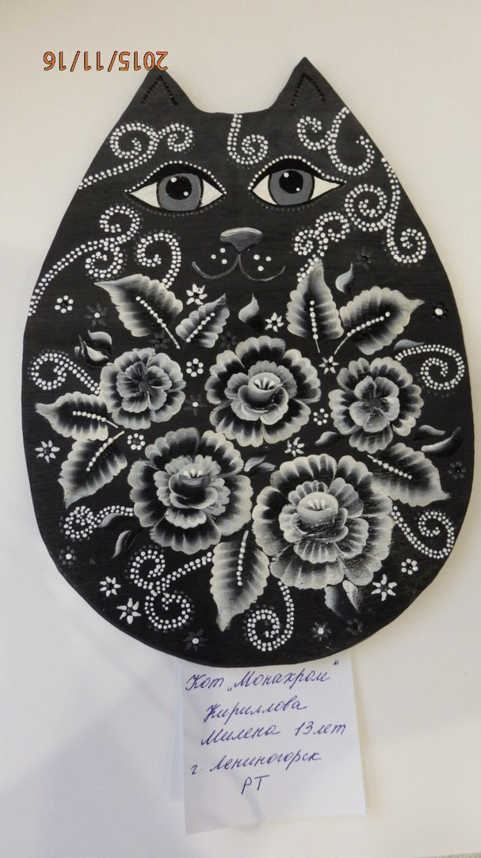
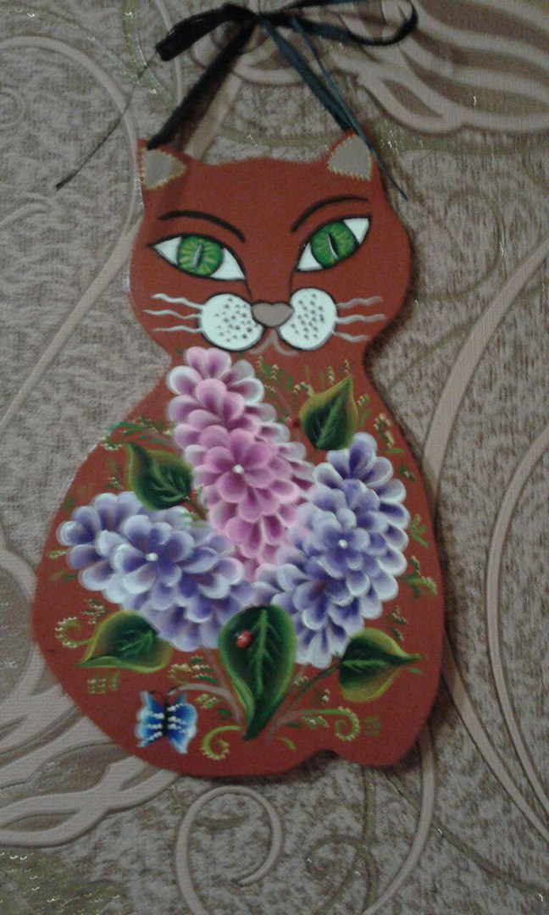
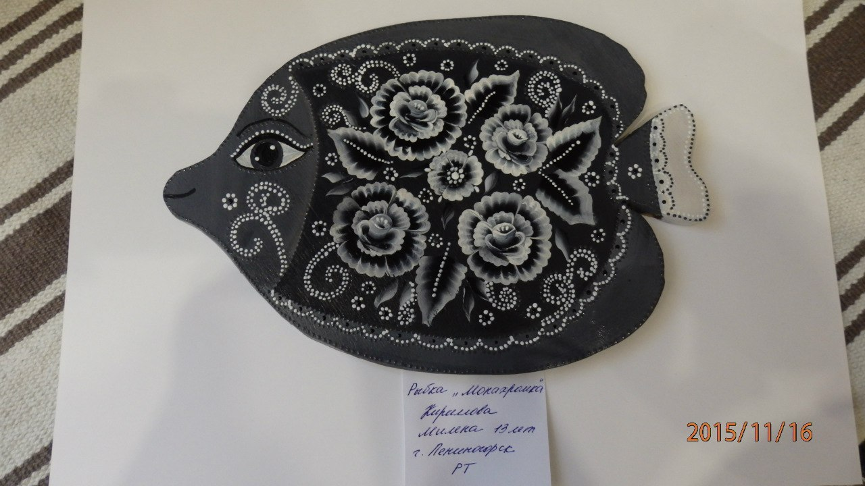
Kirillova Milena’s work.

Slide 6
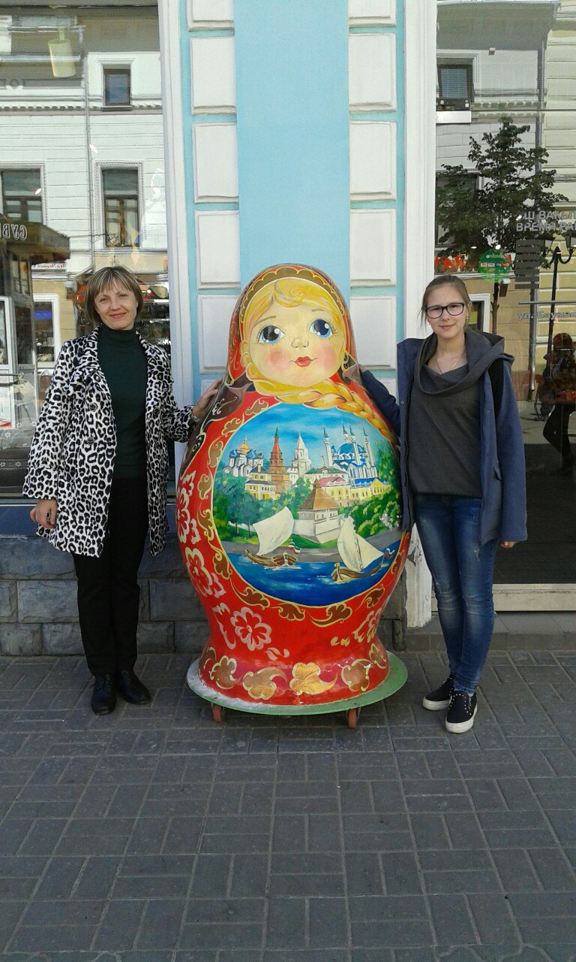
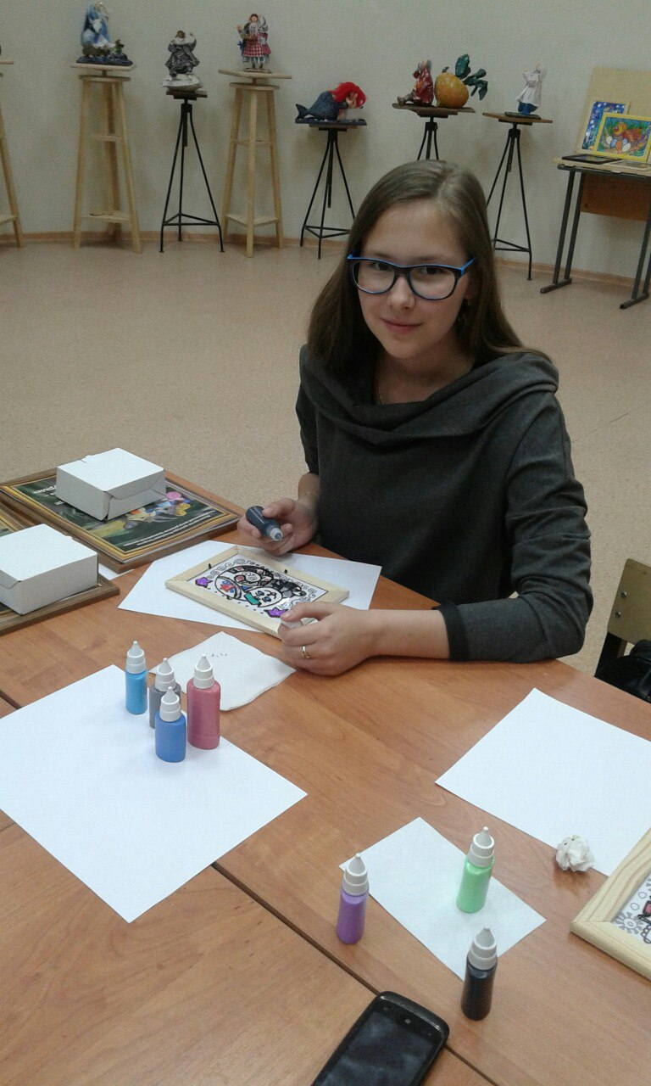
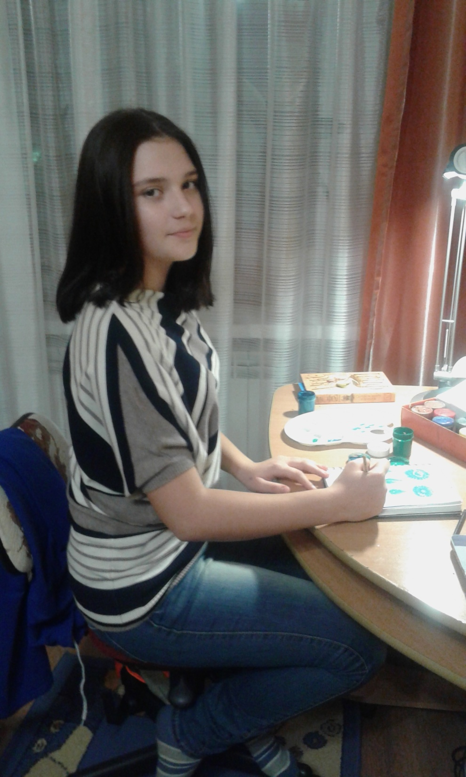
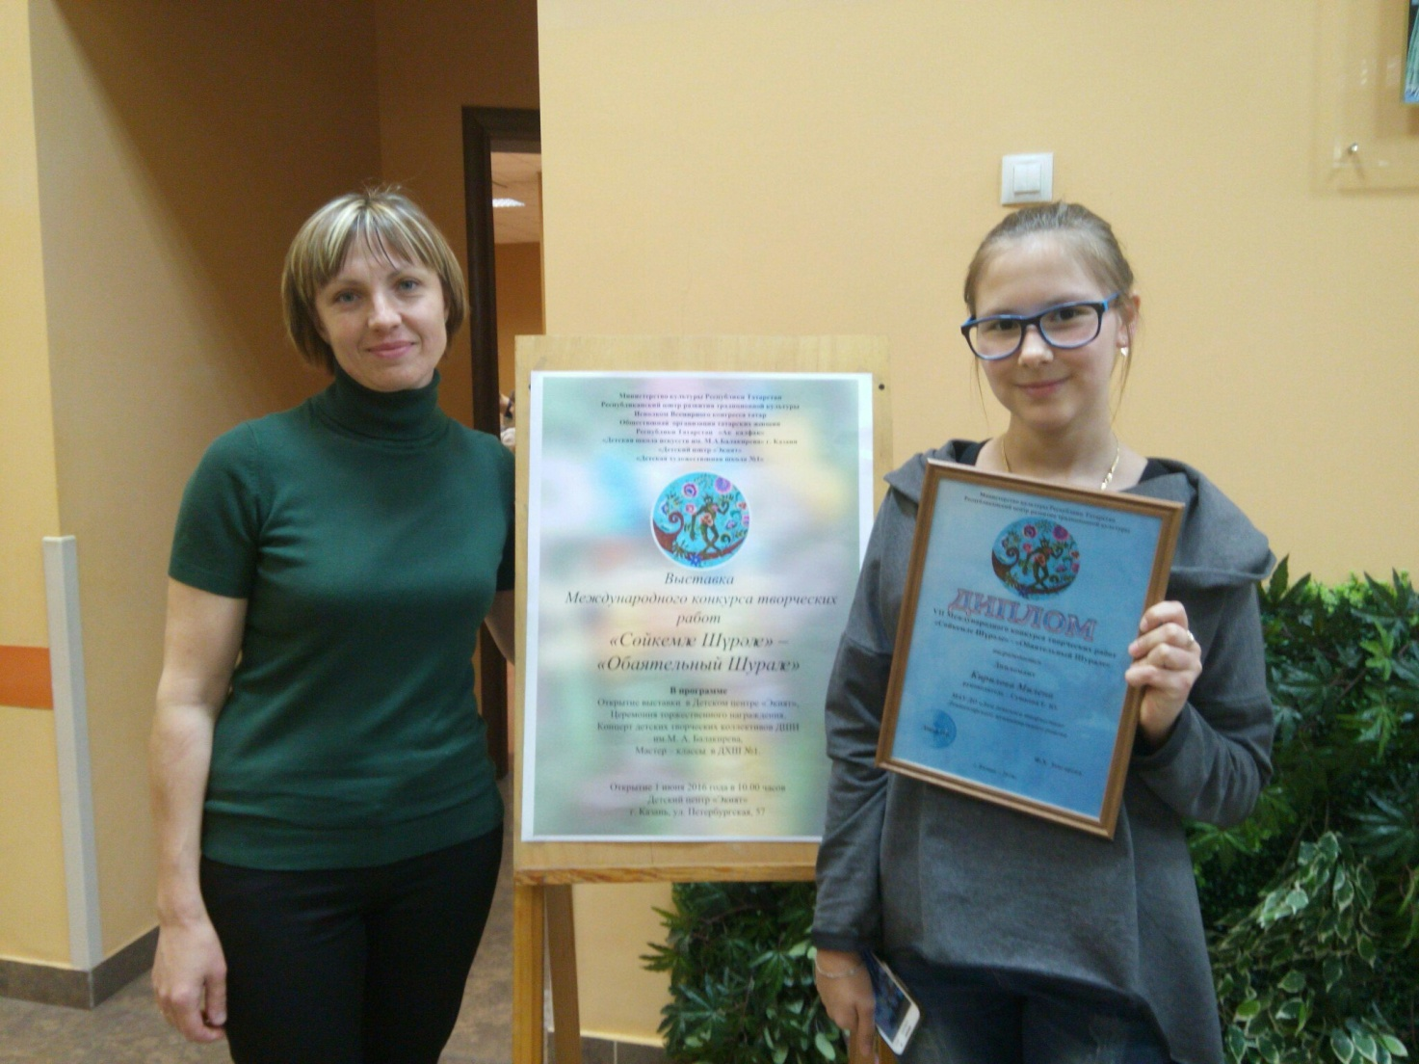
To learn more about this hobby and try to do it youself you can visit in Leninogorsk MAUD "House of children's creativity." Our skilled teacher of fine arts Sushkova Elena Yurevna will help you to creative your masterpieses, welcome. Also take part in autor’s aducatinol programm 2Decorative paiting»

Slide 7
Thank you for the attention

